Slide 1
Activation Functions

Slide 2
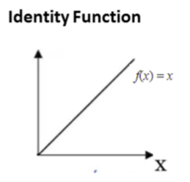
The identity function is a function that maps input to the same output value. It is a linear operator in vector space. Also, a known straight-line function where activation is proportional to the input. The simplest example of a linear activation function is a linear equation.
f(x) = a * x,where a ∈ R

Slide 3
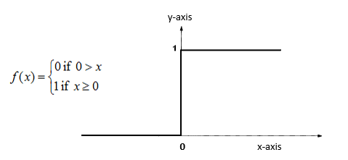
Binary Step Function
In Binary Step Function, if the value of Y is above a certain value known as the threshold,
the output is True(or activated) and if it’s less than the threshold then the output is false (or not activated).
It is very useful in the classifier.
The main problem with the binary step function is zero gradients or it is not differentiable at zero.
It cannot update the gradient in backpropagation.
It only works with binary class problems because it maps to only two categories 0 and 1.

Slide 4
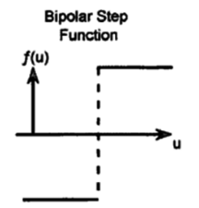
In the Bipolar Step Function, if the value of Y is above a certain value known as the threshold, the output is +1and if it’s less than the threshold then the output is -1. It has bipolar outputs (+1 to -1). It can be utilized in single-layer networks.

Slide 5
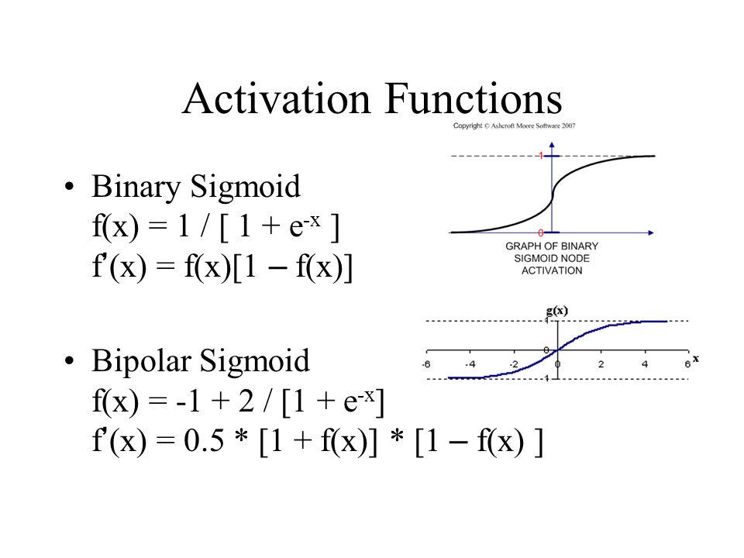
Sigmoid Function
Binary Sigmoid function (or Logistic function)
Bipolar Sigmoid function (or Hyperbolic Tangent Function or Tanh)

